Slide 1
Electrically affective hyper-redundant sensing for multi-modal sensing and learning

Slide 2
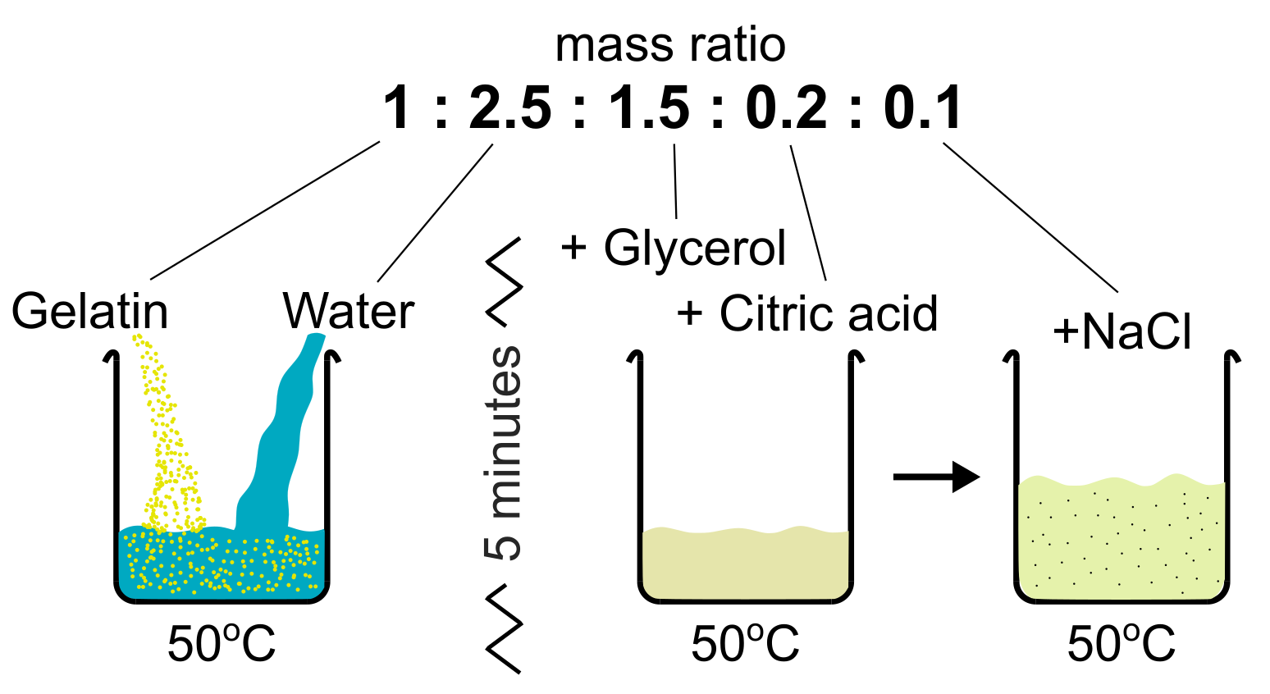
Fig1A
External Stimuli
Multi-modal Interactions
Ground Truth Data for Training
32 Electrodes
…
Current
Injection
Electrically Conductive Sensing Membrane
V
Generated Electric Field
Current Injection Sweep
32 x 31 combinations
Impedance Measurement Sweep
30 x 29 combinations
Electrical Impedance Measurement
Machine Learning
Classification
Results
863,040 channel data @ 10Hz
(32 x 31 x 30 x 29)

Slide 3
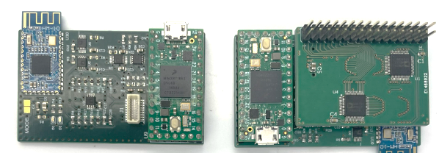
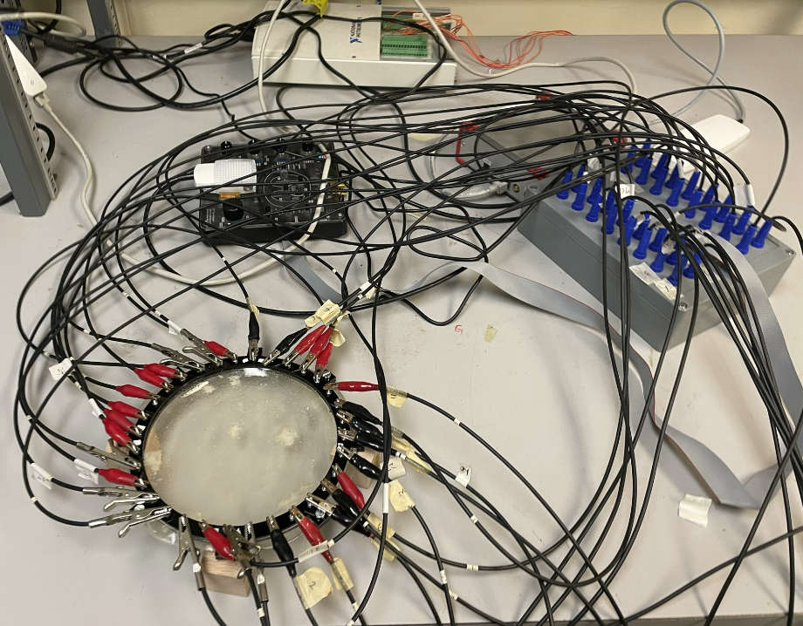
Fig1B
EIT Board
Experimental setup

Slide 4
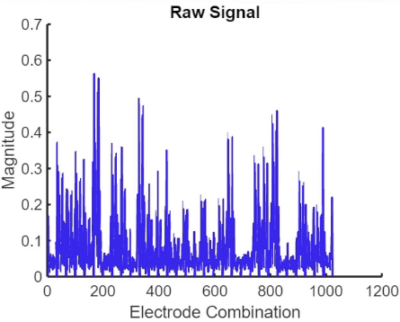
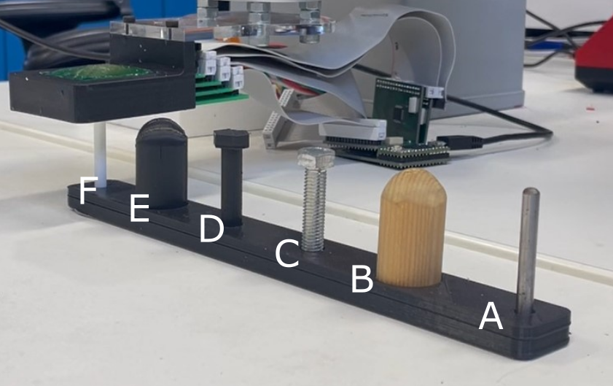
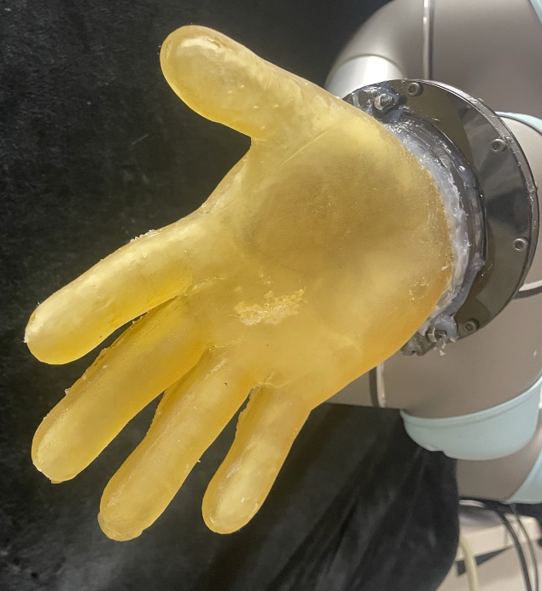

Slide 5
Fig1
Electrically
Affective
Sensing
Robot Motion
Control
Embodied
Interactions
Current
Injection
Electrically
Conductive
Functional
Materials
External
World
Electrode
Selection
Electrical
Field
Generation
EIT Controller
Machine
Learning
Sensing
Ground Truth
Training samples

Slide 6
Fig1
Electrically
Conductive
Functional
Materials
Multi-modal Stimuli
Current
Injection
Multi-modal Stimuli
Multi-modal Stimuli
Electrodes
Machine
Learning
Electrode Selection
Classification

